Slide 1
RadioPi
By: Ryan Antolin, Erick Cantos, Aldo Ndreu

Slide 2
Introduction
Throughout the semester, our group has been working hard to develop new ideas in order to integrate our previous projects.
We have taken the FM Tuner along with the Speaker Bonnet and have established connection between both of them where sound from the sensor is being outputted through the speaker module.
Our group has come up with multiple methods in order to achieve this goal which has also included designing a custom PCB board in order to accommodate both modules.
Our main goal was to produce solid integration between both projects which also included creating a database to store data (radio stations) and an android application which had the functionality to work with our hardware.

Slide 3
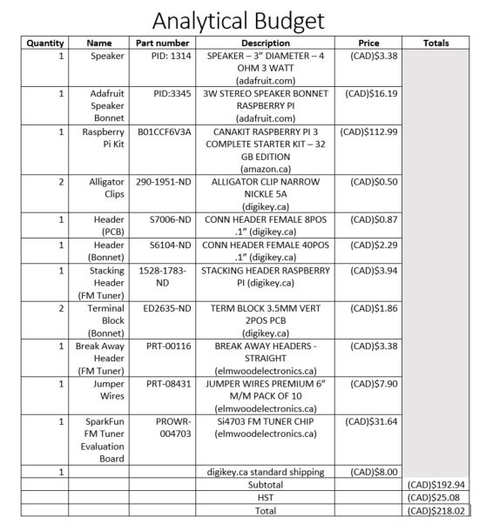
Project Budget
The budget for this project has been modified with changes that have been made during the development phase as shown in the chart below:

Slide 4
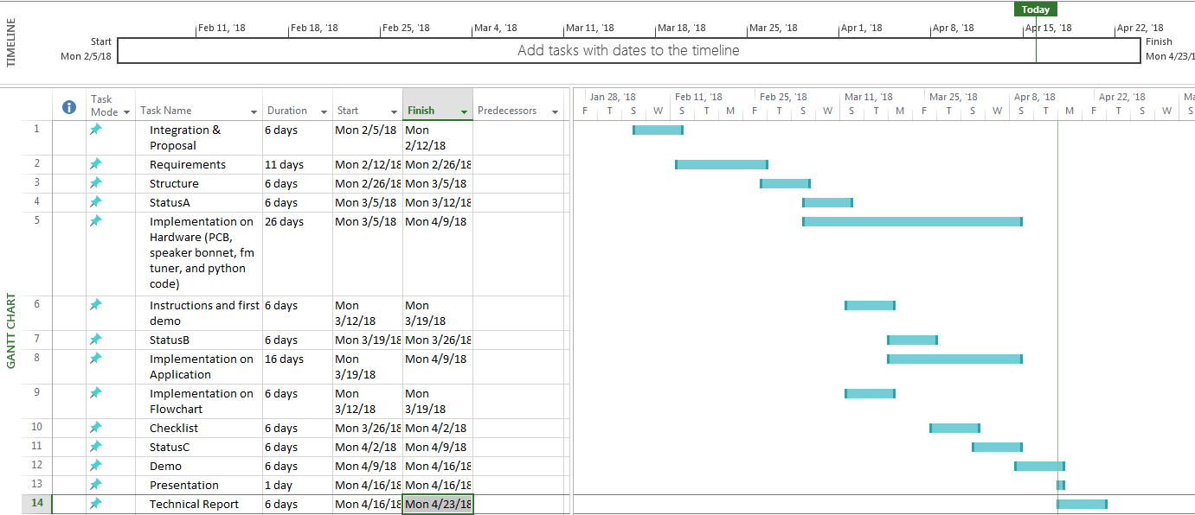
Project Schedule

Slide 5
Course Knowledge From Previous Courses
PCB Design / Soldering skills from CENG 317
Troubleshooting / Testing purposes from TECH 101
CENG 250- PC Operating Systems Internals
CENG 251 - Unix Internals
CENG 256 - Internet Programming
CENG 212 - Programming Techniques in Java
CENG 252 - Embedded Systems
CENG 254 - Database With Java
CENG 319 - Software Project

Slide 6
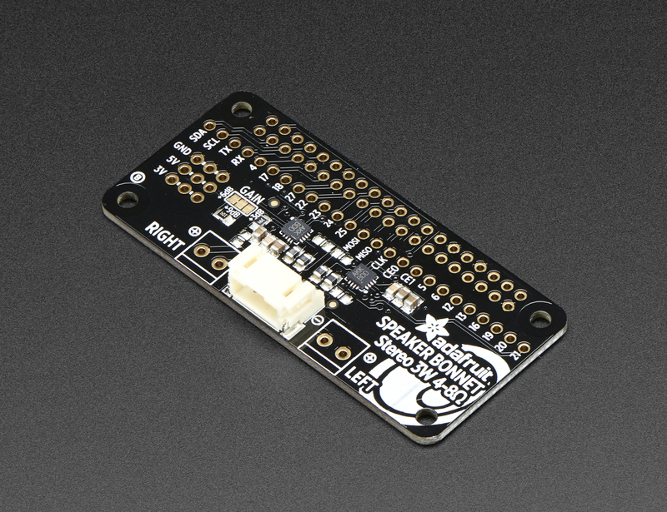
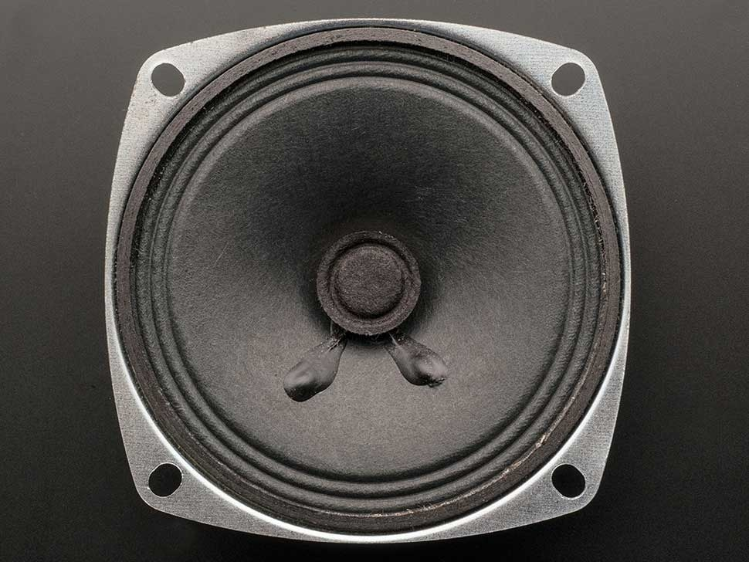
Speaker Bonnet
This Speaker Bonnet uses I2S which is a digital sound standard that is capable of producing clear and crisp audio.
The digital data goes straight to the amplifier which means there will be little to no static.
When connected to any type of speaker or speaker cone as used in our project, the user should be hearing audio by running the correct execution script.

Slide 7
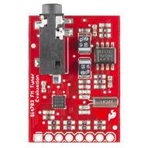
FM Tuner
The Si4703 evaluation board enables the user to tune into different FM radio stations and also does a great job of filer and carrier detection.
The output of this sensor can either be headphones/speakers which go into the 3.5mm audio jack or in this case a Speaker Bonnet which we will use to demonstrate our project.
By configuring and manipulating audio files used in the Raspberry Pi, we have altered the output destination for devices such as the Speaker Bonnet in order for it to receive the desired audio sound.

Slide 8
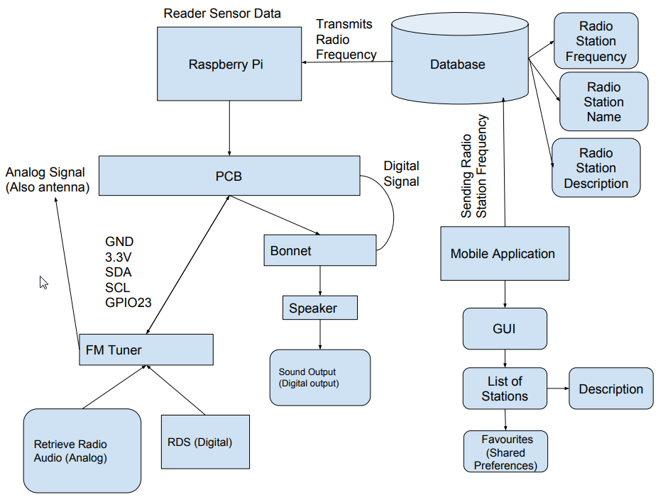
Radio Block Diagram (Flow Chart)

Slide 9
Integration
The creation of a custom PCB was vital in order to situate and combine the FM Tuner with the Speaker Bonnet.
We needed the ability to read and write data to the FM Tuner, record the frequency value, and send information to the speaker bonnet so that the modules can act in unison.
The PCB arranged a communication bridge allowing us to program the modules and adjust frequency values between the devices as needed through python scripts.
Adjusted frequency values are recorded within our firebase along with other valuable information for the radio stations.
In addition, our group has created an android app that will ultimately control these devices.

Slide 10
Integration Continued...
Python scripts were written for each device and were assigned constant tasks in order to establish an integration. So essentially this is how it works:
1. The FM Tuner will be constantly interpreting our database and adjust its frequency value if it notices any changes.
2. The android application will be in charge of writing and pushing frequency values to our database, this is how we are able to change stations.
3. Finally, the speaker bonnet will also interpret our database for a frequency value and play a matched radio stream that corresponds to the frequency value.
This design provides versatility with our speaker bonnet. The speaker bonnet can play stations that the FM Tuner is tuned into, or play separate audio from the raspberry pi if we stop the python code that runs the speaker bonnet.

Slide 11
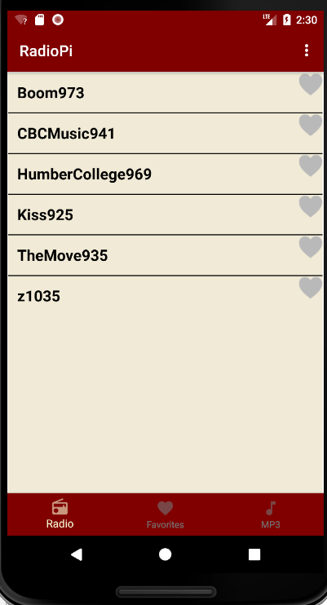
Android Application
Our android application consists of pre defined radio stations in which the user can select from. Once the user selects on a radio station, it will take them to another page which they will be prompted by a play button.
Our android application’s main functionality was to send radio frequencies to the database which is then read by our hardware project in order to play the radio stations.
Once the user clicks “PLAY”, the application will send the value to the connected database which is then picked up by the hardware and then outputs the audio from the selected radio stations. We also have integrated a favorites tab where a user can save their prefered stations.

Slide 12
Firebase
We decided to use the firebase mainly because it is able to sync data across all devices in real time. This was a real advantage for our team since we needed our modules to read and adjust to changes as quick as possible.
The single table consists of radio stations with dropdowns that provide specific information about each station. Information such as the frequency value, the name of the station, and the description are included.
Apart from the stations, there is an additional field called Frequency. This is where the radio station that the user wants to listen to is inputted. The Python scripts on the modules interpret this field and will run their tasks.
The FM Tuner will adjust its frequency value to the data entry in the Frequency field and the Speaker Bonnet will interpret the value and play the radio stream online accordingly. The android app in charge of changing that value.

Slide 13
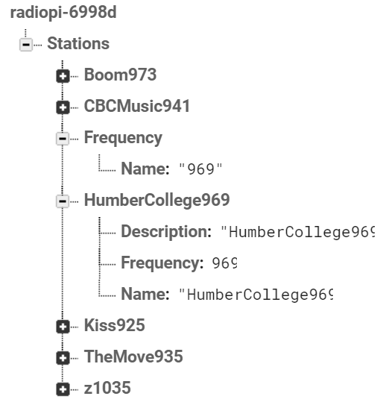
Firebase Continued...

Slide 14
Conclusion
Even though we feel our project has potential to succeed in today’s market, there is still much more room for improvement.
If we had to make thousands of our devices, we feel there would be too much competition in the market when it comes to consumers selecting similar suitable products.
The project would also be too time consuming and costly considering there are cheaper alternatives.

Slide 15
Thank You

